Slide 1
Hunger Games: The Final Showdown in GVGAI/VGDL
Raluca D. Gaina

Slide 2
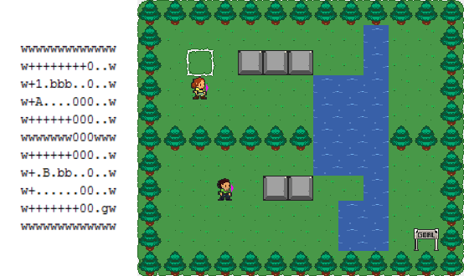
Video Game Description Language
2 text file types:
Game Description (Sprites, Interactions, Level mapping, Terminations)
Level Definition (Level layout)
BasicGame no_players=2
SpriteSet
sword > Flicker color=LIGHTGRAY limit=1 singleton=True img=sword
avatar >
robber > MovingAvatar img=avatarRed
cop > ShootAvatar stype=sword img=avatarBlue
diamond > Resource color=YELLOW limit=10 shrinkfactor=0.75 img=diamond
LevelMapping
B > cop
A > robber
x > diamond
InteractionSet
avatar wall > stepBack
robber cop sword > killSprite scoreChange=0,4
diamond robber > collectResource scoreChange=1,0
diamond cop > stepBack
TerminationSet
SpriteCounter stype=robber limit=0 win=False,True
SpriteCounter stype=diamond limit=0 win=True,False
Timeout limit=2000 win=False,False
The Bridge Level 4 Definition File and Visualisation
Cops & Robbers Game Description File

Slide 3
Initial Game Design
Fight for survival in a large forest environment.
Human vs AI.
Partial observability: fog of war.
1 main resource for players to manage: hunger (equivalent to life points).
Decreased over time
+ Decreased by killer puppies! (spawned in regular intervals, 3 at a time, chasing each player)
To increase:
Kill and eat forest animals {Random NPCs} (most) - but they leave signals when killed.
Eat forest fruits (medium)
Drink water (little)
Other collectibles:
Weapons + ammo
Hunger potions
Ultimate goal: be the last survivor (kill the other player / survive until the other dies).
Too expensive on the engine to compute, needed to bring the complexity down

Slide 4
Game Implementation Issues
Fog of war!
First attempt: sprite following avatar that spawns fog removal objects
way too many sprites and expensive!
Next: static fog removal objects around the avatar and moving relative to the avatar
VGDL said no
Final: spawn fog removal objects only when colliding with fog
YAY!
Size of the level - too many sprites, ineffective collision handling and game simulation
No time to rewrite the engine in a week
level reduced from 64x32 to 20x20

Slide 5
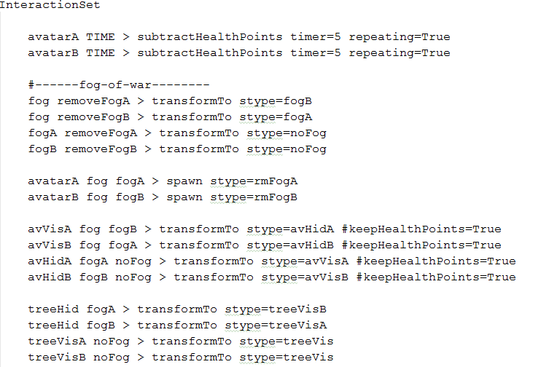
Performance Issues
Performance still bad
VGDL loops…
Avatars would continuously switch from “visible” to “hidden” state in every frame
The same error slipped through for the berry bushes, so the more bushes were revealed, the slower the game became.

Slide 6
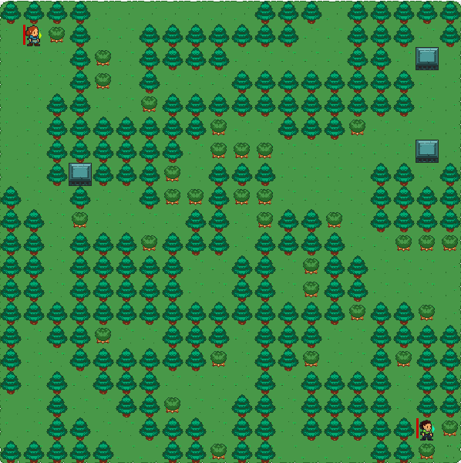
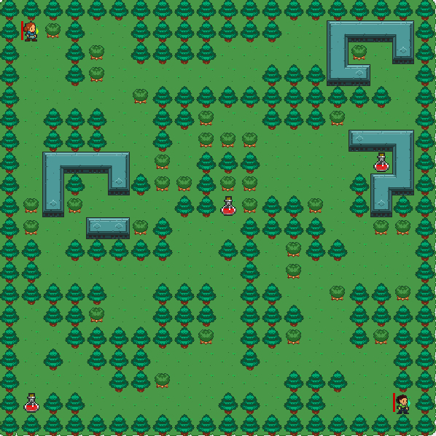
Map layout
Simplex noise used to generate trees, paths and berry bushes, adjusted manually to create a fully connected maze. Points of interest and animals manually inserted.
Not symmetric => not fair to the players (but that’s fun)
Simplex noise generator
Manual adjustments

Slide 7



Play Test #1 - Game v1
Feedback received:
Negative:
Movement awkward because you have to run away and then back to align shooting direction with the target
Can’t see life bar and resources well enough
Can’t see shooting direction
Slow fog reveal (…)
Positive:
Cool! Nice graphics! Yay for eating butterflies!
Suggestions:
Prompts for special events
Timed events to provoke player interaction / spikes in gameplay (i.e. food in the middle visible to all players)

Slide 8
Play Test #2 - Game v2 + AI v1
Feedback received:
Negative:
AI dies too quickly to puppies.
Positive:
Killer puppies: awesome! (and secretly Jeremy’s favourite feature)
Still cool!
Best VGDL Game !?

Slide 9
Play Test #3 - Game v2 + AI v2
Feedback received:
Negative:
Too much food.
Hard to distinguish between players.
Arrows seem useless.
Positive:
Pretty cool.
Very fun, would play again.
Suggestions
Too intimate experience with the AI!
Prompt when losing health, confusing health drain from the wolves.

Slide 10
Initial AI Design - Rolling Horizon Evolution
FSM
Explore
Collect Resources
Attack
Defend
Wander behaviour using A* Pathfinding
RHEA with heuristic oriented towards approaching & hitting target
RHEA with heuristic oriented towards fleeing from target
RHEA with heuristic oriented towards resources

Slide 11
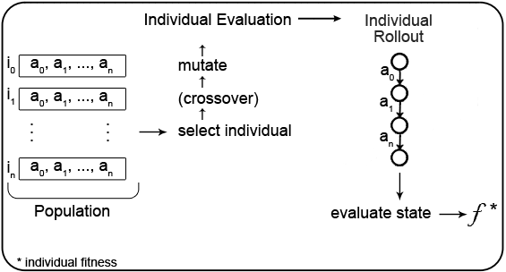
Rolling Horizon Evolution

Slide 12
FSM & Fitness Function
Lost enemy
Lost enemy
No resource close
Default state: explore
State: Attack
State: Defend
State: Collect
Distance to enemy < 5?
yes
yes
no
no
Health points > Enemy health points OR crazy?
opponent bad NPC
f = resourceCount - PENALTY × moved? - w₂ × distance(targetPosition) + distMoved + w₁ × healthPoints
f = - w₂ × distance(Enemy) + w₁ × resourceCount
f = w₂ × distance(Enemy) + w₁ × resourceCount + w₁ × healthPoints
f = w₂ × resourceCount + w₂ × healthPoints - distance(Resource)
f += w₃ × gameScore + BONUS × win? - w₁ × npcCount - PENALTY × overlapping(Enemy)?
Final Fitness

Slide 13
Conclusions
Game - success! (Sort of …)
Fog of war!
Killer puppies!
Life and death!
Where did that tree come from?!
Om nom nom butterfly!
AI - success! (Sort of …)
Still too general and likes puppies too much.
Ignores most of FSM awesomeness and does what it pleases (i.e. hit trees with sticks).
Game too expensive for many generations to be iterated through in real time.

Slide 14
More work
Optimize engine performance to support large and heavy games.
Full map generation with automatic map adjustment for fully connected maze.
Expand game to more than 2 players.
Test GVGAI agents on this more complex challenge and analyse their performance.

Slide 15
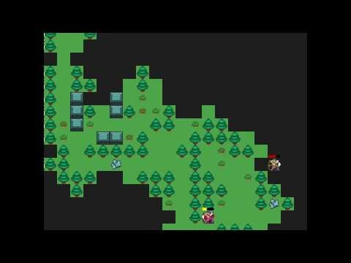
Pretty video
Thank you! - Questions?

